Slide 1


BORCELLE
BORCELLE
NUNIT
Software Testing
PRESENTATION

Slide 2
TEAM 3
CHAU QUOC BAO
Nguyen Duc Quy
Chu Vuong Manh
Tran Le Huy
02

Slide 3

WHAT IS NUNIT?
NUnit is a popular open-source unit testing framework for .NET that was initially developed as a port of JUnit to the .NET platform.
+
It is designed to facilitate the creation and execution of automated tests, allowing developers to verify the correctness of their code.
+

Slide 4

WHY NUNIT IS IMPORTANT?
+
Mitigates errors
+
Boosts code robustness
+
Optimizes testing efforts in software development.

Slide 5
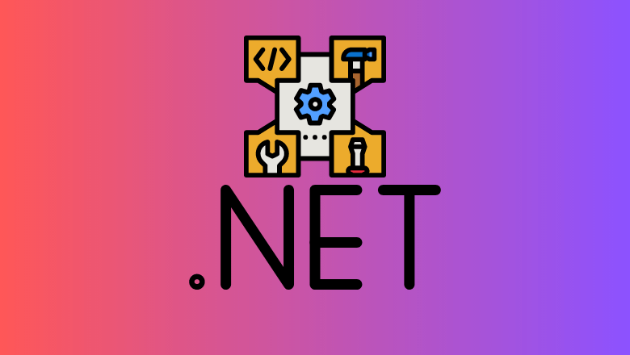
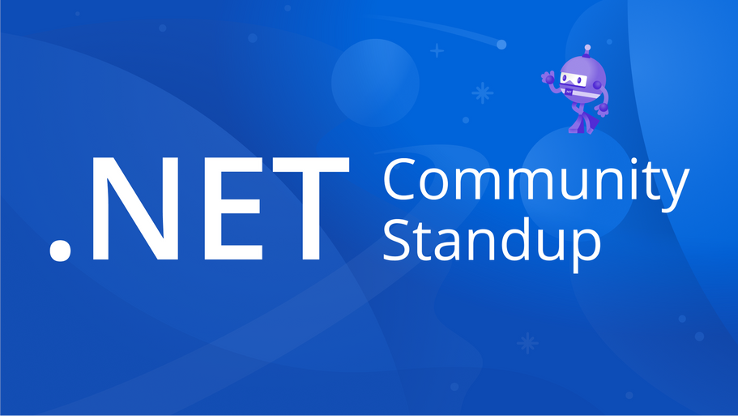
WHO USE NUNIT?
NUnit is tailored for .NET developers, and NUnit is indispensable for efficient unit testing.

Slide 6



CUSTOMER REFERENCE
Trusted by industry leaders, NUnit played a key role in projects like TradeX , SkyQuest ,
OpenSourceLib , ShopSite

Slide 7

HISTORY OF NUNIT
Inception (2000): Founded by Charlie Poole to introduce effective unit testing to .NET.
Evolution and Popularity: Rapidly gained popularity, becoming a fundamental testing framework in the early 2000s.

Slide 8

HISTORY OF NUNIT
Open Source Growth: The transition to open source led to widespread adoption and continuous evolution.
Legacy Today: NUnit stands as a key player, shaping modern development practices in the .NET community.

Slide 9
NUNIT ARCHITECTURE
Built on xUnit architecture, contains 3 layers:
+) Test Runner Layer
+) Test Engine Layer
+) Framework Layer
Nunit boasts a layered architecture designed for extensibility and flexibility and provides a structured testing environment for diverse scenarios.

Slide 10
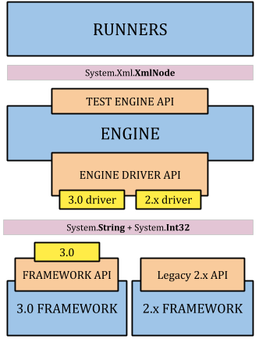

Slide 11
HIGHLIGHTS
Data-Driven Testing: Supports tests with various data sets.
SetUp and TearDown: Defines pre/post-test conditions using [SetUp] and [TearDown].
Test Dependency: Express dependencies for a logical test order.

Slide 12
PROS
+)Extensive functionality
+) Strong library
+) Support for test organization

Slide 13
CONS
+)Smaller ecosystem
+) Limited IDE integration
+) Lack of advanced features

Slide 14
ADDITIONAL KEY FEATURES OF NUNIT
Test Categories:
[Category] for targeted testing.
Test Execution Order:
Control execution sequence.
Mocking Framework Integration:
Seamless Moq integration.

Slide 15
ADDITIONAL KEY FEATURES OF NUNIT
Dynamic Tests:
Runtime test creation.
Console Runner and VS Integration:
Command-line execution, VS Test Explorer integration.

Slide 16
Q&A

Slide 17
THANK YOU!

